Slide 1

Submitted by Raviprasad bathina

Slide 2
Micro-Credit Defaulter Model
Basic Introduction of the Project:
This project is based on giving micro credit loan to the customers. Microcredit is a common form of microfinance that involves an extremely small loan given to an individual to help them become self-employed or grow a small business. These borrowers tend to be low-income individuals, especially from less developed countries (LDCs).

Slide 3
Problem Statement:
Today, microfinance is widely accepted as a poverty-reduction tool, representing $70 billion in outstanding loans and a global outreach of 200 million clients.
We are working with one such client that is in Telecom Industry from Indonesia. The company provide micro credit loan to their customers. They understand the importance of communication and how it affects a person’s life, thus, focusing on providing their services and products to low income families and poor customers that can help them in the need of hour.
In this project the sample data is provided to us from our client database. In order to improve the selection of customers for the credit, the client wants some predictions that could help them in further investment and improvement in selection of customers.
So we build a machine learning model that helps to understand the company that who is defaulter customer and who is not based on the sample data.

Slide 4
Data Cleaning Steps:
First we check the information of the given dataset because it tells that how many rows and columns are present in our dataset and data type of the columns whether they are object, integer or float.
Drop duplicates rows if present in dataset.+
Then we check for the null values present in our dataset. If null values are present then fill it via mean, median or mode. Or also you can remove that rows but kindly check it properly.
After that we check the summary statistics of our dataset. This part tells about the statistics of our dataset i.e. mean, median, max value ,min values and also it tell whether outliers are present in our dataset or not.

Slide 5
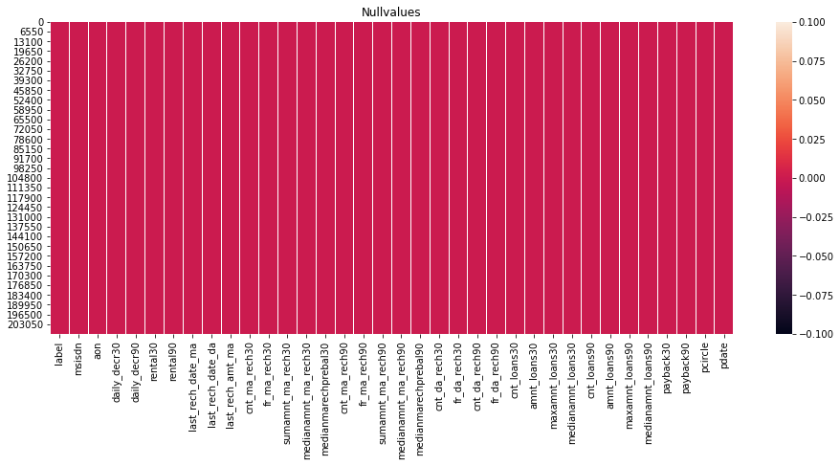
Showing no Null values

Slide 6
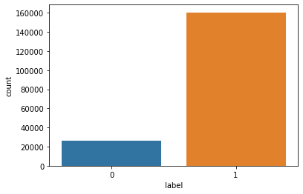
Target variable label is not balanced

Slide 7
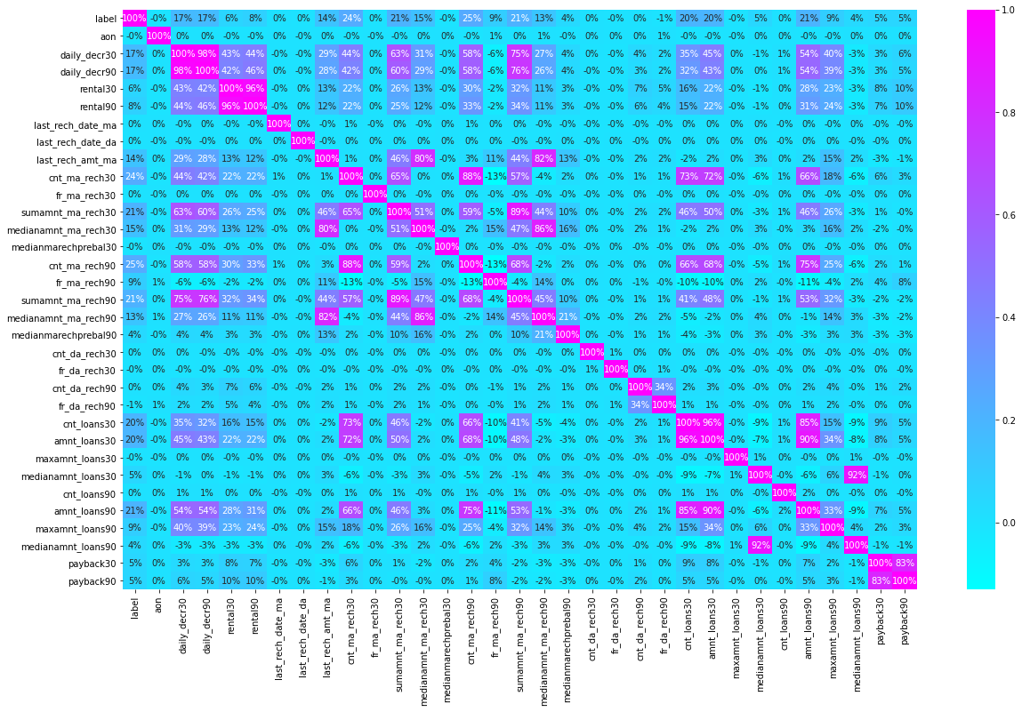
Correlation
Observation:
1-daily_decr30 and daily_decr90 features are highly correlated with each other.
2-rental30 and rental90 features are highly correlated with each other.
3-cnt_loans30 and amount_loans30 columns are highly correlated with each other.
4-amount_loans30 is also highly correlated with amount_loans90 column.
5-medianamnt_loans30 and medianamnt_loans90 is highly correlated with each other.

Slide 8
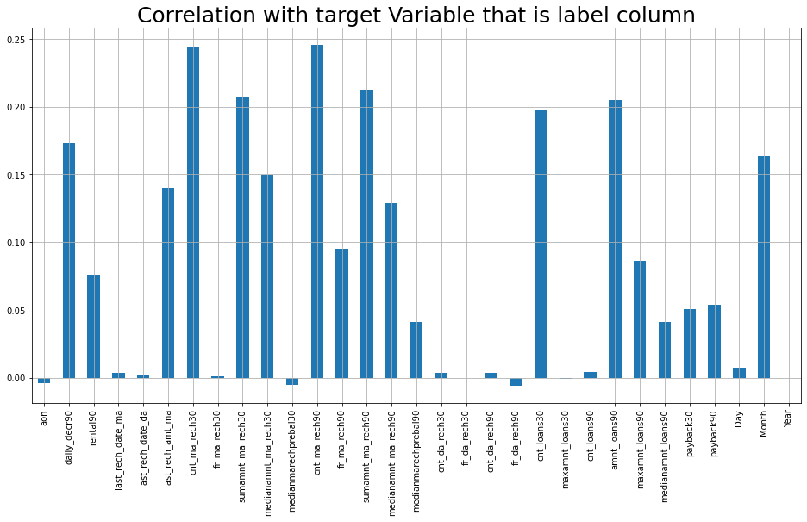
Correlation with target variable

Slide 9
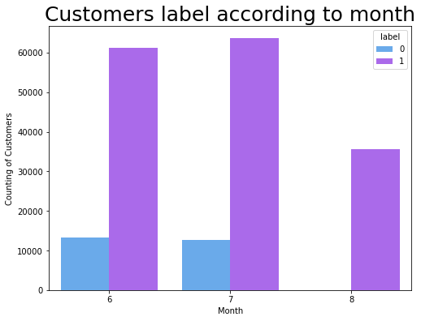
Observation: There are several customers at June and July month who did not pay their loan.

Slide 10
Data Cleaning steps continued
We also check the correlation of our dataset to check the correlation of the columns with eachother. If columns are highly correlated with each other let’s say 90% or above then remove those columns to avoid multicolinearity problem.
We extract data from date column and make new columns like day, month and year to see the outcomes with our target column that is label.
We delete the pcircle column because it has only one unique value that tells that collected data is only for one circle.
We cannot remove outliers because more than 20% of our data are removed.

Slide 11
Visualization:
We plot correlation matrix via heatmap to see the correlation of the columns with other columns.
We also visualize the correlation of columns with target column via bar graph to see which column is highly correlated with target column.
We see the number of defaulter and non defaulter customers with the help of count plot.
We plot histogram to displays the shape and spread of continuous sample data.
We also see the customers labels i.e defaluter/Non-defaulter according to date and month with count plot.
We also see the distribution of the data with the help of distribution plot whether it is left skewed or right skewed.

Slide 12
Modeling Parts:
We know that this is classification problem so we use accuracy score, classification report and confusion matrix as our eveluation matrix. We also see the AUC score and also plot the AUC_ROC curve for our final model.
As we know this dataset is imbalance so we have to balance the data using SMOTE
We use different classifiers but Random Forest Classifier as our evaluation model using hyperparameter tuning gives us best accuracy our dataset is too large and it takes more than hour to give the result.

Slide 13
Sampling Techniques:
Now we use Sampling technique to balance our dataset and then apply Random Forest classifier model and see the results.
Under Sampling: By using the under sampling we are trying to reduce the points of maximum labels.
Over Sampling: By using the over sampling we are trying to increase the points of minimum labels.
SMOTETomek: SMOTETomek is a hybrid method which uses on under sampling method (Tomek) in with over sampling method (SMOTE).

Slide 14
Finalize the Model:
Over Sampling model gives the best result among all the model so we keep this model as our final model.
We use Randomforest Classifier with over sampled data and it gives best Recall and AUC Score as well as fi_score.
Accuracy score is very good approx 91% and AUC score is 98%.
We also plot the AUC ROC curve for this model.
We save this model as our final model as a pickle file with the help of Joblib.

Slide 15
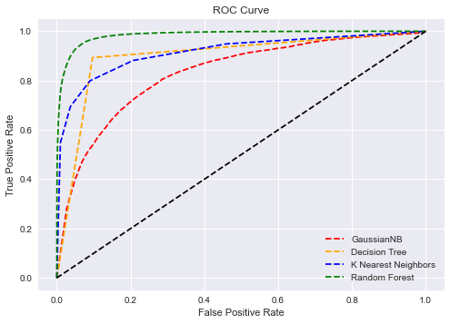
Random forest gives best accuracy91% and auc score 98%

Slide 16
Conclusion of the Project:
In this project the sample data is provided to us from our client database. The Consumer is believed to be defaulter if he deviates from the path of paying back the loaned amount within the time duration of 5 days.
We make a machine learning model in order to improve the selection of customers for the credit.
The client wants some predictions that could help them in further investment and improvement in selection of customers and our ML model helps them.

